Slide 1

Insurance company Complaints, Resolutions , Status and Recoveries
Under The Guidance: Prof. Chaojie wang
Project by:-
Vandana Buduru

Slide 2
Introduction
Insurance is a contract (policy) in which an insurer indemnifies another against losses from specific contingencies or perils.
There are many types of insurance policies. Life , health , homeowners, and auto are the most common forms of insurance.
Providing Security ,Spreading of Risk ,Source for Collecting Funds , Encourage Savings

Slide 3
Dataset
Data source : https://data.ct.gov/Business/Insurance-Company- Complaints-Resolutions-Status-an/t64r-mt64
No. of Rows: 24,842
No. of Columns: 12
Column | Description
Company | Name of the Insurance Company
File No | Conjure problem primary identification number
Opened | Date on which the complaint is registered
Closed | Date on which the complaint is resolved
Coverage | Either Group/Individual Coverage
Sub-Coverage | Specific Coverage types like health, dental, life, etc.,
Reason | The broad reason for the insurance complaint
Sub Reason | The reason for the insurance complaint at the low granular level
Disposition | Disposition of the claim or policy

Slide 4
Column | Description
Recovery | Amount recovered by the claim
Status | Current Status of the insurance complaint

Slide 5

Goal of the project
This project aims at building a complete data science project which analyzes the listing of consumer complaints filed against Insurance companies licensed in Connecticut. This dataset includes the Company, Line of Business, nature of complaint, outcome or resolution, and recovery
This application can be used by any agency, Insurance industry stakeholders, or the general public to predict the status of consumer filings against the insurance companies
To develop an end-to-end data science application that is used by any insurance industry stakeholders to predict the status of the problem, status regarding their insurance policy issues.

Slide 6
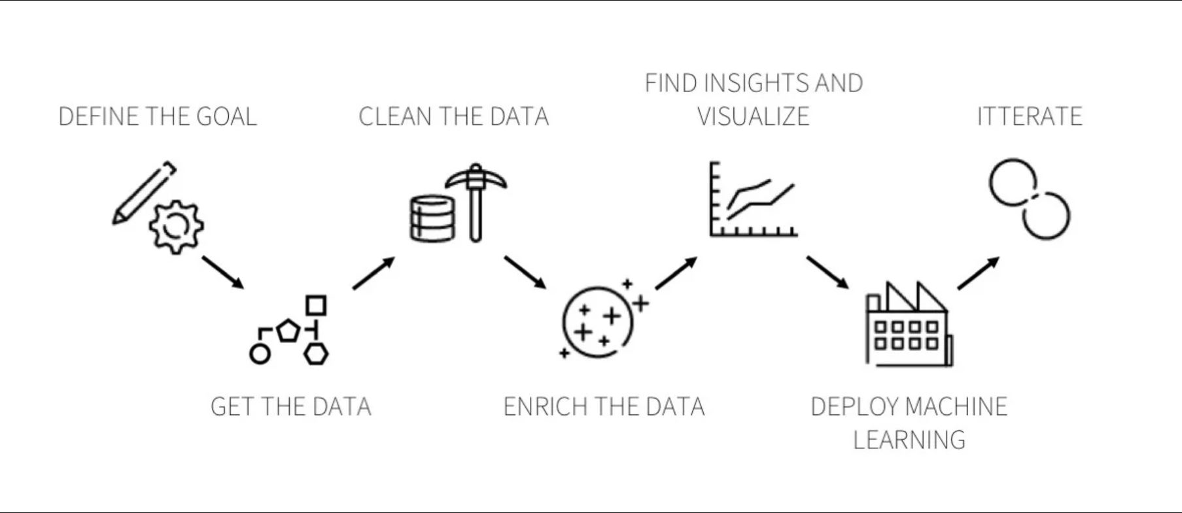
Research Process

Slide 7

Exploratory data analysis

Slide 8
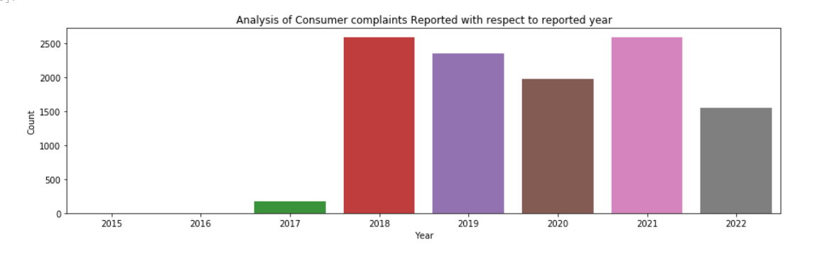
1. Consumer complaints reported with respect to year:
2021, 2018 are the years with most consumer complaints reported.

Slide 9
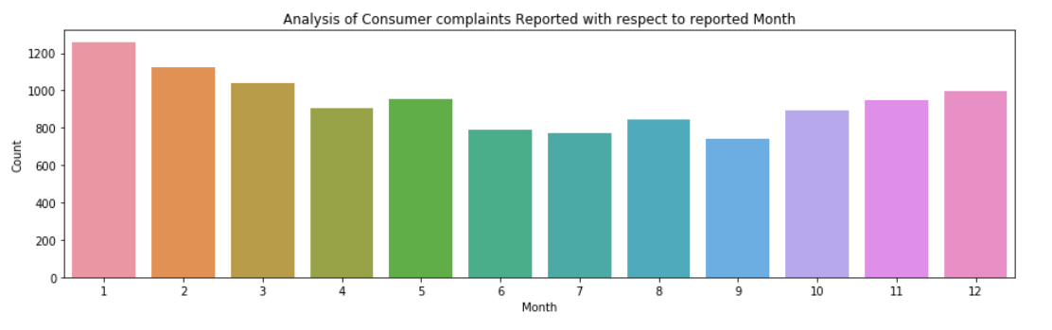
2. Displaying Complaints filed by Month:
January is month with most consumer complaints reported.

Slide 10
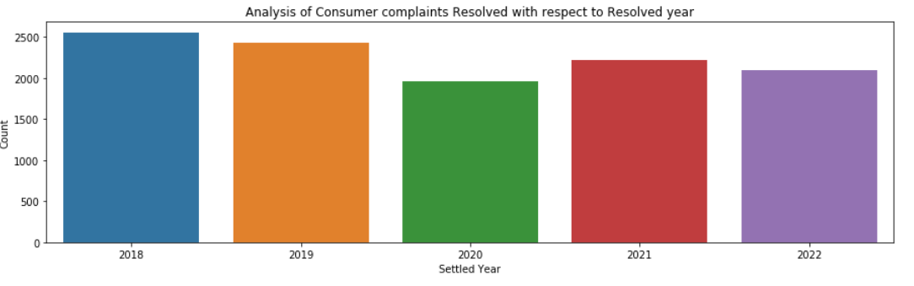
3. Displaying Complaints filed by Resolved Year:
2018, 2021 are the years with most consumer complaints settled/resolved.

Slide 11

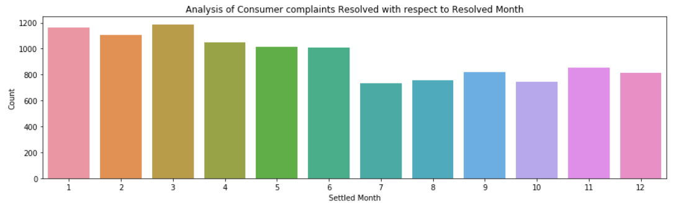
4. Displaying Complaints filed by Resolved Month:
March, January are the months with most consumer complaints resolved.

Slide 12
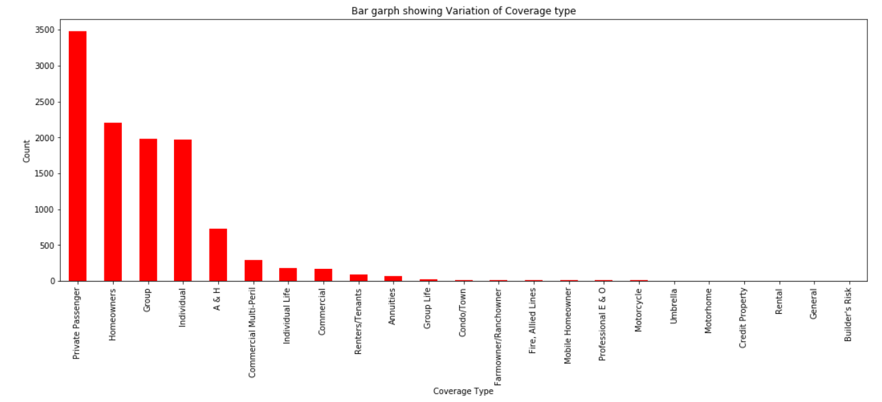
5. Plotting the bar graph for Coverage Type and its individual counts:
Travel Insurances and Home insurances are the most sought after insurance policies.

Slide 13
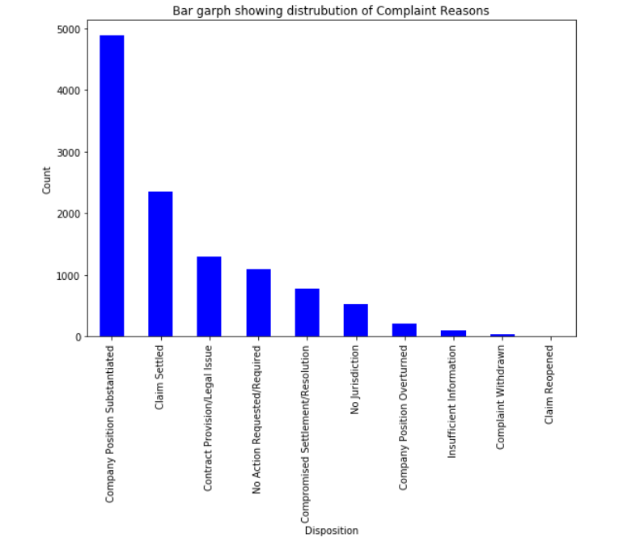
6. Plotting the bar graph for Disposition Types :
We can see that the disposition type Company Position Substantiated has the highest values in the dataset

Slide 14
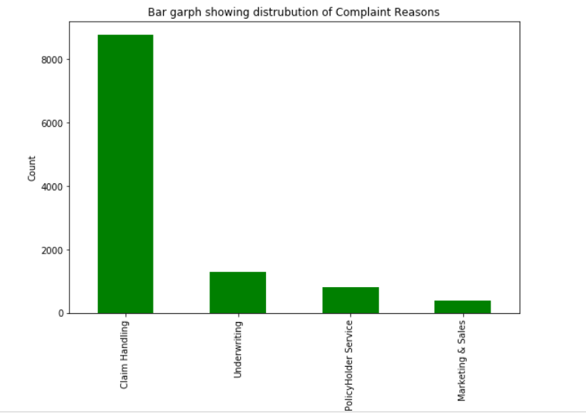
7. Plotting the bar garph for Claim Reasons:
The improper claim settlements are the primary reason for complaint filings.

Slide 15
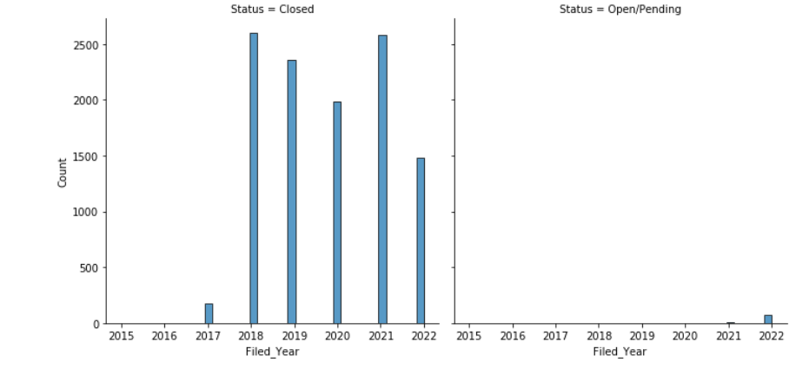
8. Plotting the variation of Complaint status vs. Filed Year:
2021 is the year with most complaints filed and 2022 is the year with most of them resolved

Slide 16

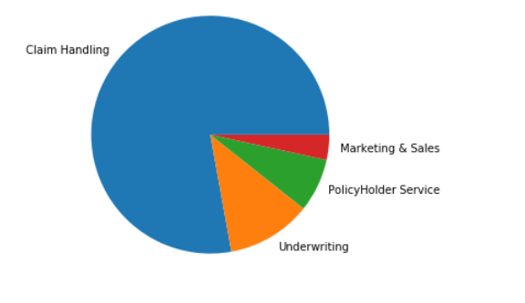
9. Depicting the reasons and their percent of share in complaint filings
The improper claim settlements are the primary reason for
complaint filings.

Slide 17

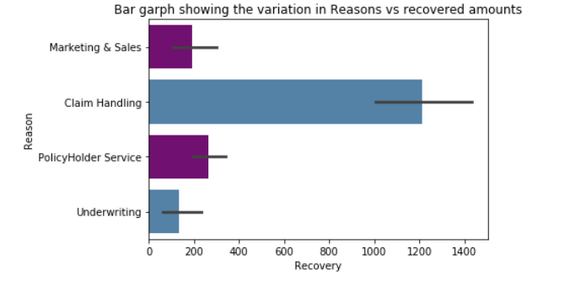
10. Plotting the variation in Reasons vs. recovered amounts
Claim handling segment is the most highest segment with high recovery amounts then followed by complaints due to marketing and sales segments.

Slide 18
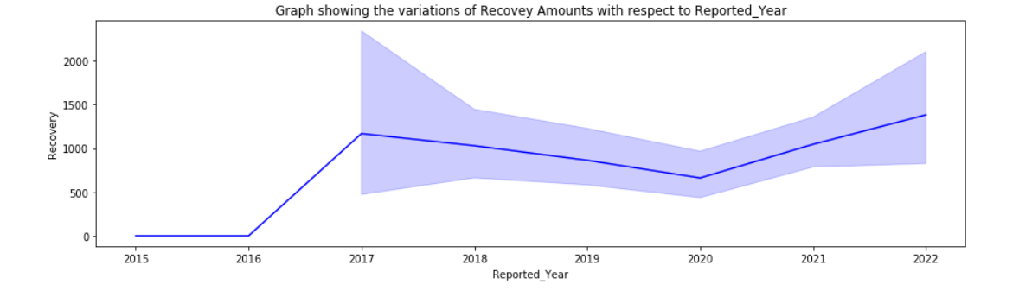
11. Graph showing the variations of Recovery Amounts with respect to Reported Year :
2018 is the year with highest sum of claims recovered

Slide 19
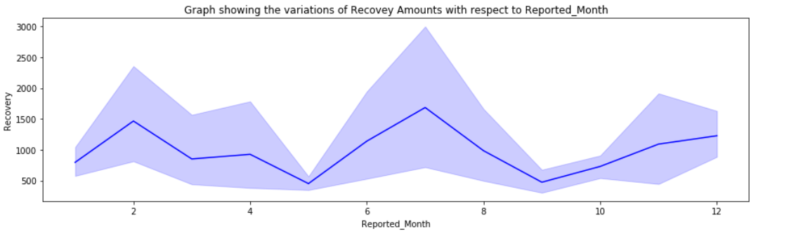
12. Graph showing the variations of Recovey Amounts with respect to Reported_Month:
February is the Month with highest sum of claims recovered.

Slide 20
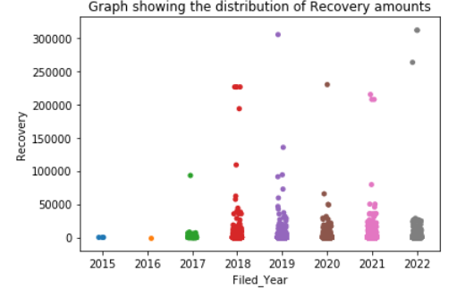

13. Graph showing the distribution of Recovery amounts :

Slide 21
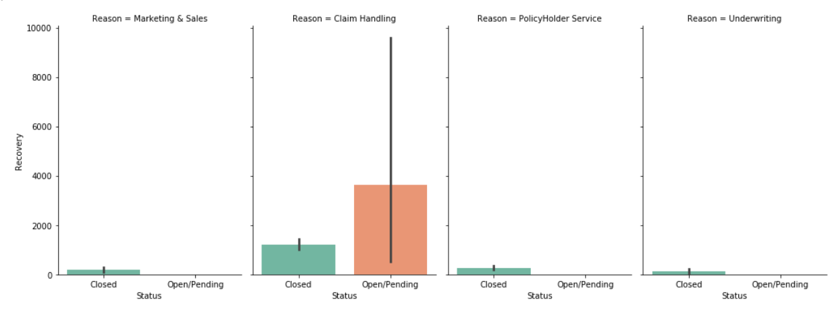
14. Graph showing the variation if complaint status vs. Recovery amounts and Reason filed

Slide 22
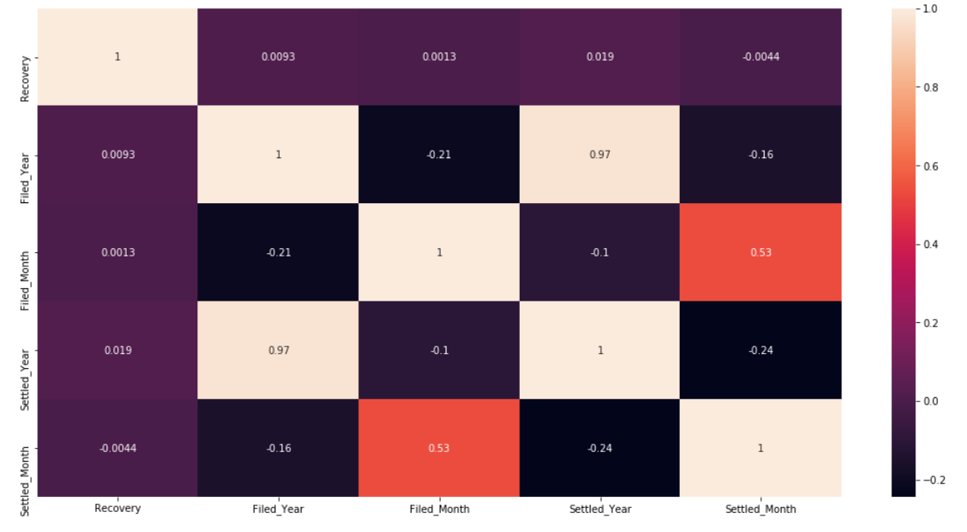
15. Correlation matrix:

Slide 23

Feature ENGINEERING
Chi Square test-
The Chi-Square test is best defined as a statistical hypothesis test. This test is used either for comparing a group having a value or in comparing multiple groups with categorical data. The advantages of this test are the robustness with respect to the given data.
It can only be used when two categorical variables are there and related to some population. The Chi-square test is a goodness fit statistic because it measures how well the observation data fits the distributed data.

Slide 24
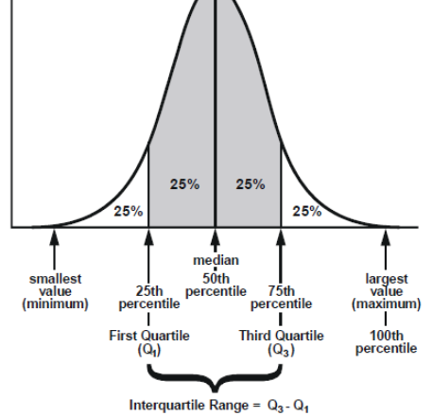
InterQuartileRange:
The interquartile range defines the difference between the third and the first quartile. Quartiles are the partitioned values that divide the whole series into 4 equal parts. So, there are 3 quartiles. First Quartile is denoted by Q₁ known as the lower quartile, the second Quartile is denoted by Q₂ and the third Quartile is denoted by Q₃ known as the upper quartile. Therefore, the interquartile range is equal to the upper quartile minus lower quartile. The difference between the upper and lower quartile is known as the interquartile range. The formula for the interquartile range is given below
Interquartile range = Upper Quartile – Lower Quartile = Q_{­3} – Q_{­1}

Slide 25
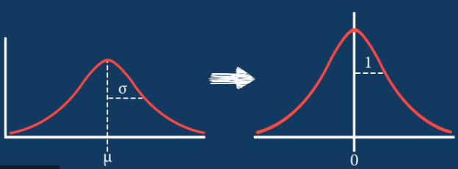
Feature Scaling:
Standardization : Standardization is another scaling technique where the values are centred around the mean with a unit standard deviation. This means that the mean of the attribute becomes zero and the resultant distribution has a unit standard deviation is the mean of the feature values and is the standard deviation of the feature values
Normalization: Normalization is a scaling technique in which values are shifted and rescaled so that they end up ranging between 0 and 1. It is also known as Min-Max scaling. Xmax and Xmin are the maximum and the minimum values of the feature respectively

Slide 26

Machine learning models

Slide 27
Evaluation metric: F1-Score
F1 score is defined as the harmonic mean between precision and recall. It is used as a statistical measure to rate performance. In other words, an F1-score (from 0 to 9, 0 being lowest and 9 being the highest) is a mean of an individual’s performance, based on two factors i.e. precision and recall
Precision is defined as the accuracy of judgment. For example, in a random population sample of 100 people, to be counted for composition of male and female, Person A estimates the count of male population to be 70. If actually, the male count is 70 in the lot, Person A is said to have a 100% precision. Essentially, it is the ratio of estimates converting into reality
The metrics such as Precision, Sensitivity, Recall, Specificity, F-Score, ROC-AUC Curve is used to evaluate the binary or multi class Classification problem
Here, we could observe that the data in target variable is imbalanced, here we could use the F-1 Score. F-1 score is generally useful when working with the imbalanced dataset and it combines precision and recall into a single number as it is harmonic mean of precision and recall
Basically. harmonic mean penalises unequal values more. So, as our data is imbalanced it's better to use F-Score as evaluation metric

Slide 28
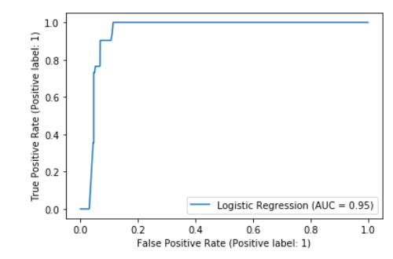
1.Logistic regression:
f1_score is 94.1% with Logistic Regression with L2 penalty and AUC value is 96% that implies, the model is 96% accurate in distinguishing the classes.

Slide 29
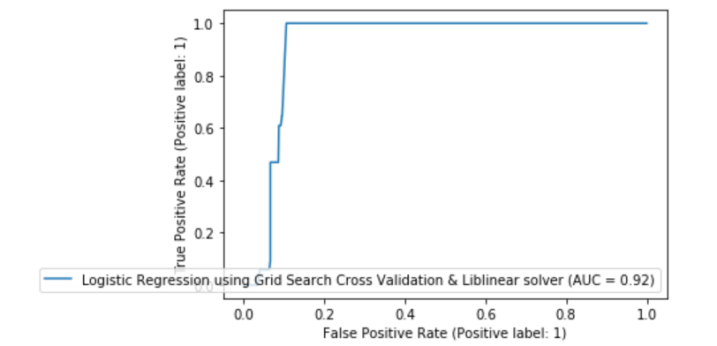
2.Logistic Regression using Grid Search Cross Validation & Liblinear solver:
Training accuracy and Test accuracy are close to each other, so there is no case of over-fitting or under-fitting.
f1_score is 94.1% with Logistic Regression with 10 folds Cross Validation,L2 penalty and liblinear solver.

Slide 30
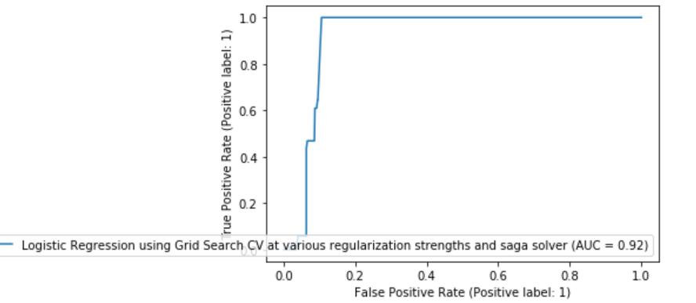
3.Logistic Regression using Grid Search Cross Validation & SAGA SOLVER:
Training accuracy and Test accuracy are close to each other, so there is no case of over-fitting or under-fitting.
f1_score is 94.1% with Logistic Regression with 10 folds Cross Validation,L2 penalty and Saga solver.

Slide 31
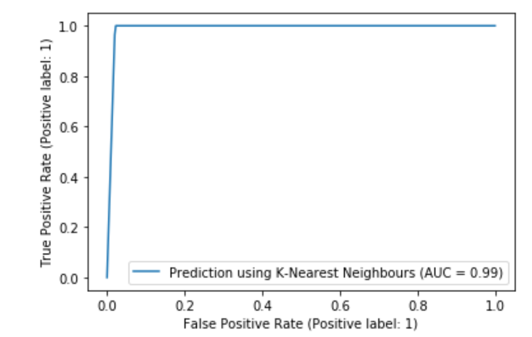
4.K-Nearest Neighbours:
Training accuracy and Test accuracy are close to each other, so there is no case of over-fitting or under-fitting.
f1_score is 99.1% using K-Nearest Neighbors, which is better then Logistic regression.

Slide 32
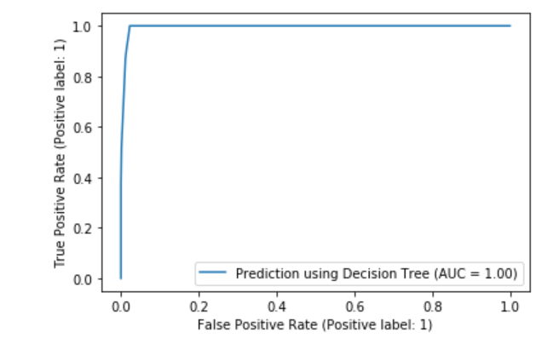
5.Decision Tree:
Training accuracy and Test accuracy are close to each other, so there is no case of over-fitting or under-fitting.
f1_score is 99.1% using Decision Tree, which is better then Logistic regression and K-Nearest Neighbours.

Slide 33
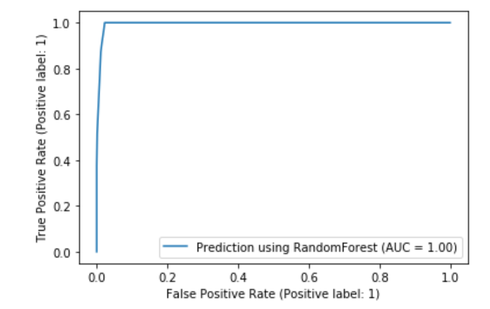
6.Random Forest:
Training accuracy and Test accuracy are close to each other, so there is no case of over-fitting or under-fitting.
f1_score is 99.1% using Random Forest, which is better then Logistic regression and K-Nearest Neighbours and quiet comparable to the decision tree algorithm.

Slide 34
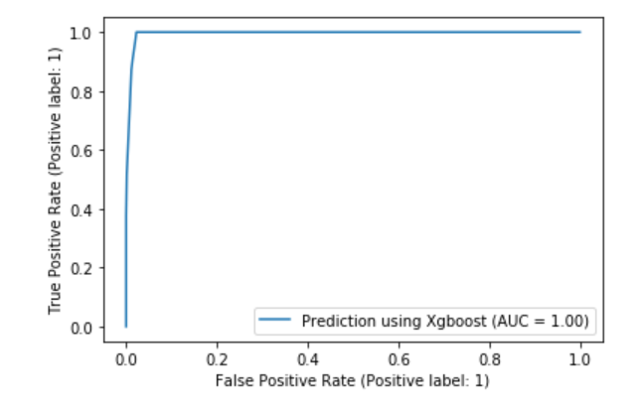
7.Xgboost:
Training accuracy and Test accuracy are close to each other, so there is no case of over-fitting or under-fitting.
f1_score is 99.1% using Xgboost classifier, which is better then Logistic regression and K-Nearest Neighbours and quiet comparable to the decision tree and Random Forest algorithm.

Slide 35
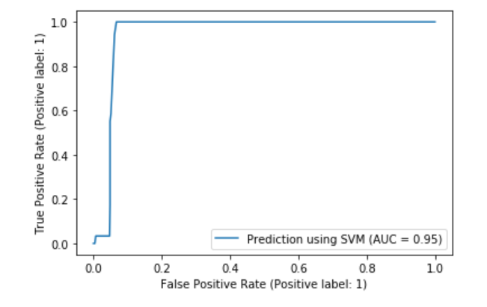
8.SVM:
Training accuracy and Test accuracy are close to each other, so there is no case of over-fitting or under-fitting.
f1_score is 96.9% using SVM classifier, which is better then Logistic regression and K-Nearest Neighbours and lower than decision tree, Xgboost and RandomForest algorithm.

Slide 36
Outcomes:
Model | F1-Score
Logistic regression | 94.1%
Logistic Regression using Grid Search CV at various regularization strengths and liblinear solver | 94.1%
Logistic Regression using Grid Search CV at various regularization strengths and saga solver | 94.1%
K-Nearest Neighbour | 99.1%
Decision tree | 99.1%
Random Forest | 99.1%
Xgboost | 99.1%
SVM | 96.9%

Slide 37
conclusions
1) The metrics such as Precision, Sensitivity, Recall, Specificity, F-Score, ROC-AUC Curve is used to evaluate the Classification problem. Here, we could observe that the output data is slightly imbalanced, here we could use the F-1 Score. F-1 score is generally useful when working with the imbalanced dataset and it also combines precision with recall into a single metric.
2) f1_score is 94.1% with Logistic Regression with L2 penalty and AUC value is 96% that implies, the model is 96% accurate in distinguishing the classes.
3) f1_score is 94.1% with Logistic Regression with 10 folds Cross Validation,L2 penalty and liblinear solver.
4) f1_score is 94.1% with Logistic Regression with 10 folds Cross Validation,L2 penalty and Saga solver.
5) f1_score is 99.1% using K-Nearest Neighbours, which is better then Logistic regression.
6) f1_score is 99.1% using Decision Tree, which is better then Logistic regression and K-Nearest Neighbours.
7) f1_score is 99.1% using Random Forest, which is better then Logistic regression and K-Nearest Neighbours and quiet comparable to the decision tree algorithm.
8) f1_score is 99.1% using Xgboost classifier, which is better then Logistic regression and K-Nearest Neighbours and quiet comparable to the decision tree and Random Forest algorithm.
9) f1_score is 96.9% using SVM classifier, which is better then Logistic regression and K-Nearest Neighbours and lower than decision tree, Xgboost and Random Forest algorithm.
10) By comparing all the above implemented models, we can conclude that K-Nearest Neighbours, Decision Tree, Random Forest, Xgboost classifiers has improved the performance of the model and any one of the models can be choose for practical business applications.

Slide 38
References:
https://www.researchgate.net/profile/BattaMahesh/publication/344717762_Machine_Learning_Algorithms_-A_Review/links/5f8b2365299bf1b53e2d243a/Machine-Learning-Algorithms-A-Review.pdf?eid=5082902844932096
https://www.taylorfrancis.com/books/mono/10.1201/9781315371658/machine-learning-mohssen-mohammed-muhammad-badruddin-khan-eihab-bashier-mohammed-bashier
https://books.google.co.in/books?hl=en&lr=&id=_-ZDDwAAQBAJ&oi=fnd&pg=PP1&dq=machine+learning+algorithms+&ots=epiHB2BE7F&sig=UB8IhCVnH3kh4OJqu077k4luyy8&redir_esc=y#v=onepage&q=machine%20learning%20algorithms&f=false
https://www.researchgate.net/profile/J-E-T-Akinsola/publication/318338750_Supervised_Machine_Learning_Algorithms_Classification_and_Comparison/links/596481dd0f7e9b819497e265/Supervised-Machine-Learning-Algorithms-Classification-and-Comparison.pdf
Notes:
1.

Slide 39
THANK YOU

